Slide 1
NLP with Deep Learning

Slide 2
Deep Learning
Subfield of machine learning concerned with algorithms .
structure and function of the brain called artificial neural networks.

Slide 3
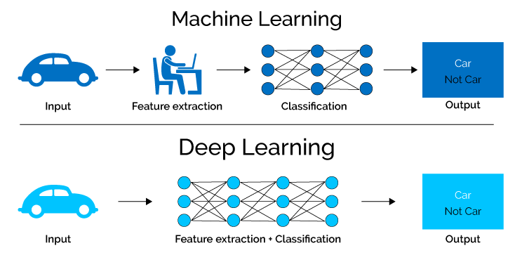
Limitations of Machine Learning
Feature Extraction of Text and Images
Back Propogation.
Poor Computation.

Slide 4
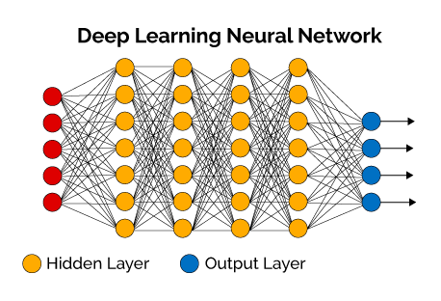
Neural Network
Involves a large number of PROCESSORS operating in parallel and arranged in tiers .
3 layers:
(1)Input Layer
(2)Hidden Layer
(3)Output Layer

Slide 5
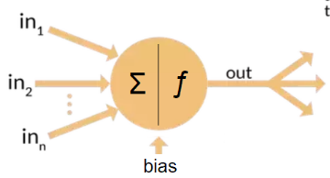
Neuron
Node that takes input , make computation and send output to next neuron.

Slide 6
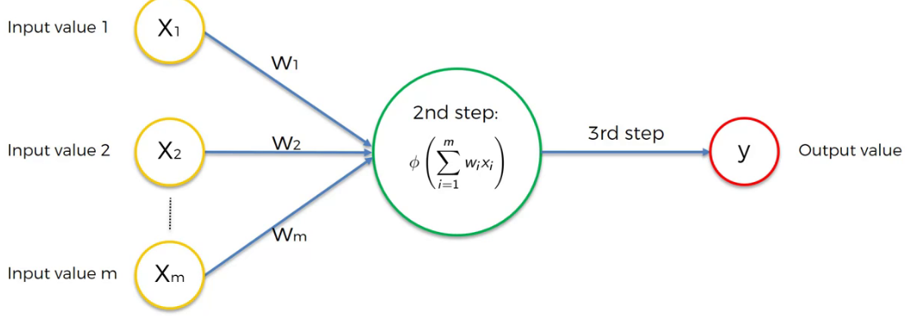
Process in each neuron
(1) multiplication of weight and value and addition .
(2)Activation function
(3) Passes signal to next signal

Slide 7
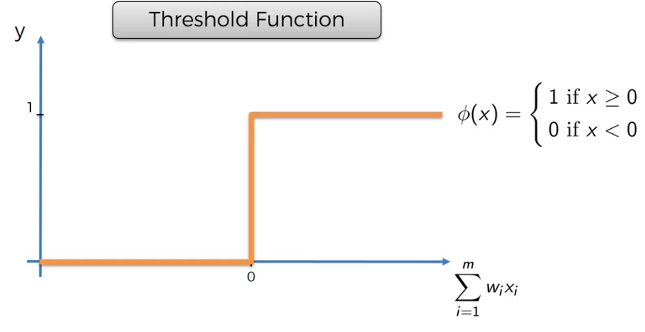
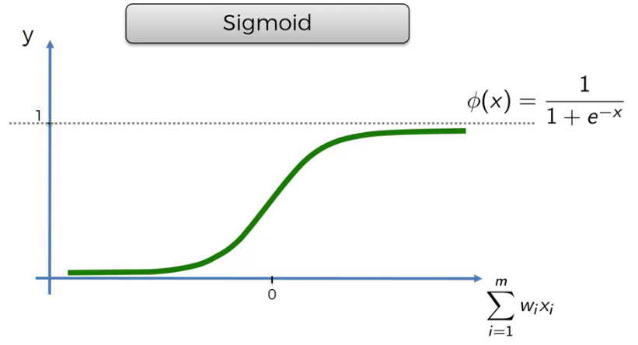
Activation Function
(1)Threshold Function
(2) Sigmoid Function

Slide 8
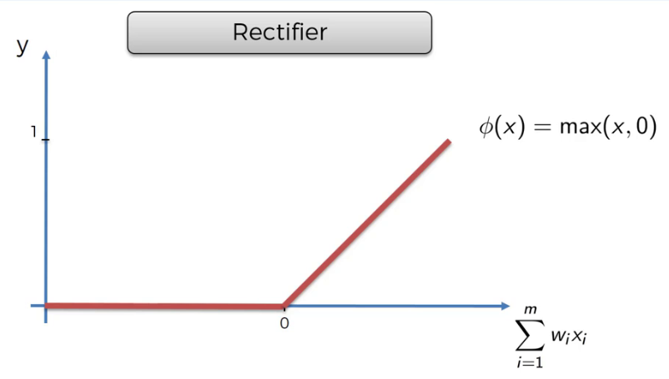
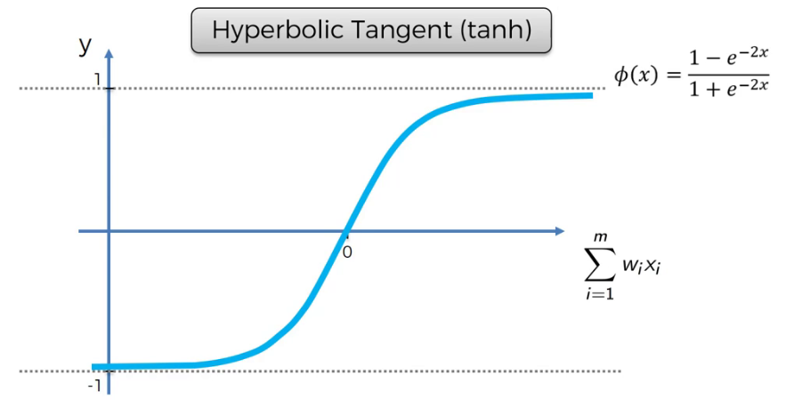
Activation Function
(3)Rectifier Function
(4) Hyperbolic tangent function

Slide 9
Activation Function
Rectifier function is most used function
Sigmoid function is used in Final Layer

Slide 10
How NN Learn
Initialize weights
Forward propagation
Find Cost function
Back Propagation
Change Weights
Repeat until Cost Function is lowest

Slide 11
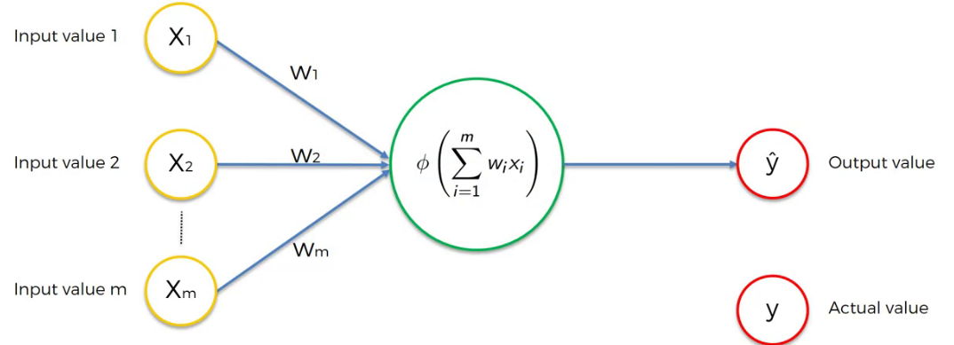
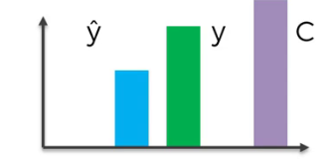
How NN Learn
Cost = 0.5 * (y –Y)^2

Slide 12
Convolutional Neural Network
Convolution
+
Pooling
+
Flattening
+
Connection with Neural Network

Slide 13
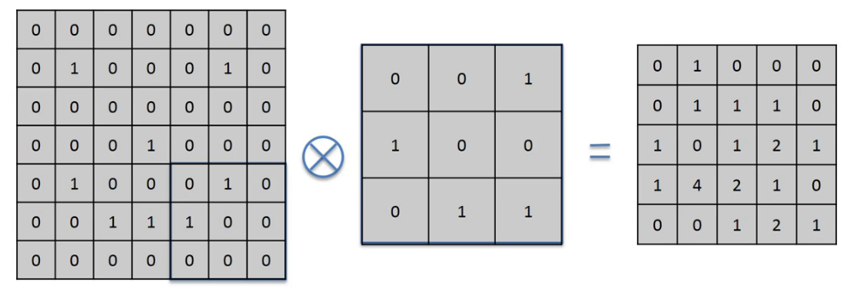
Convolution
Feature Extraction
Input Feature Detector Feature

Slide 14
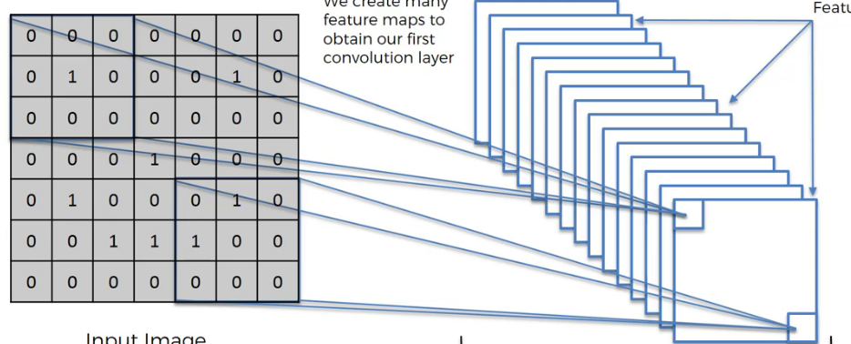
Convolution

Slide 15
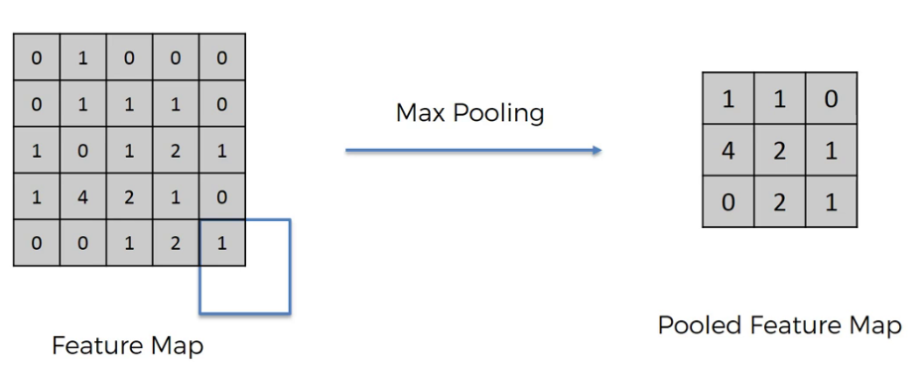
Pooling
Reduce Size of feature
Reduce parameters
Prevent overfitting

Slide 16
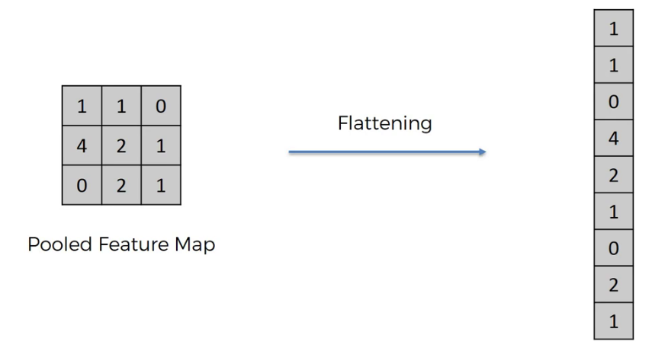
Flattening
Convert to input of next Layer

Slide 17
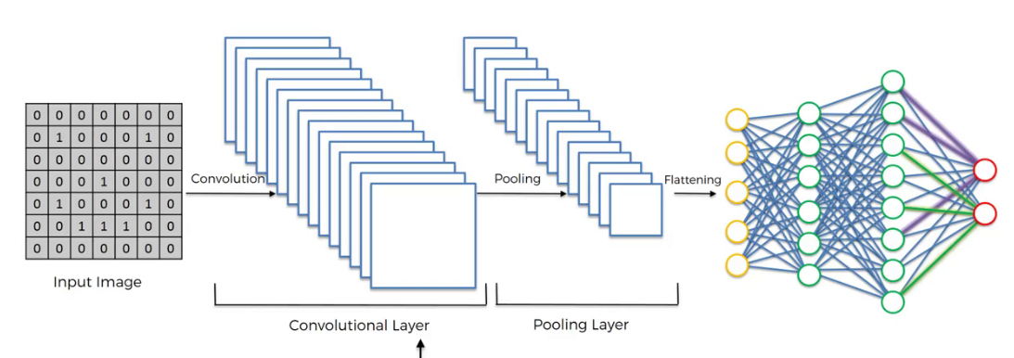
Full Connection

Slide 18
Thank You

